Slide 1
Learning Graph Database – Neo4j

Slide 2
Outline
Objectives and Intents
Graph Database
Modeling
Cypher Query Language
GraphGist

Slide 3
Modeling Workflow
Goal
Problem Space
Scenarios and Questions
Graph Database
Use Cases and Queries
Discussion

Slide 4
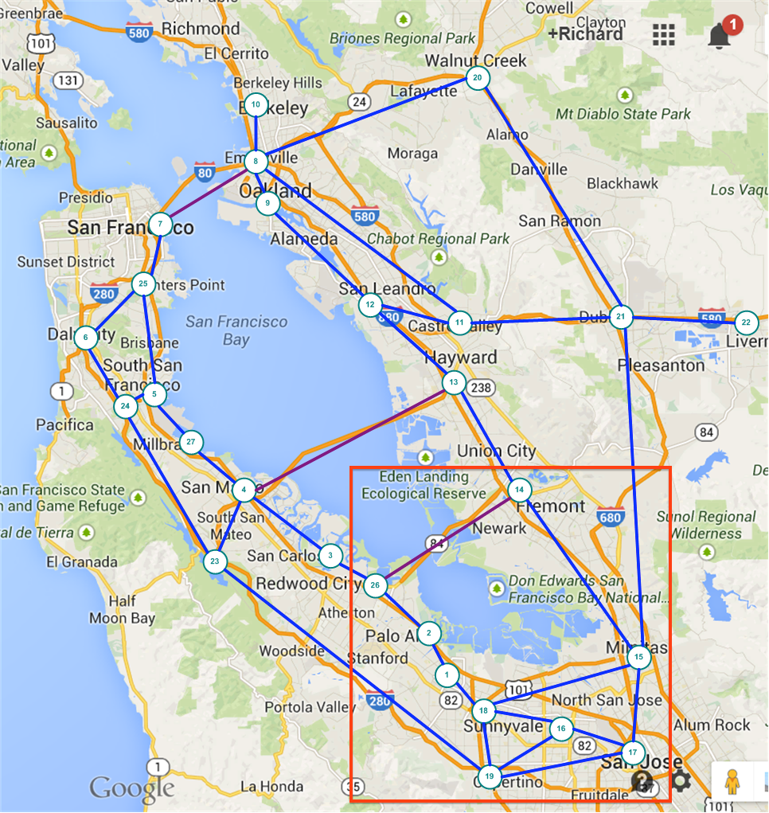
Using San Francisco Road Map to Understand Some Concepts in Social Networking and Graph Database

Slide 5
Objects in Domain
Cities
name, population
population growth, incoming workers, out coming workers
has major facilities (school, airport, sport stadium,..)
Roads connect Cities
name, distance (length)

Slide 6
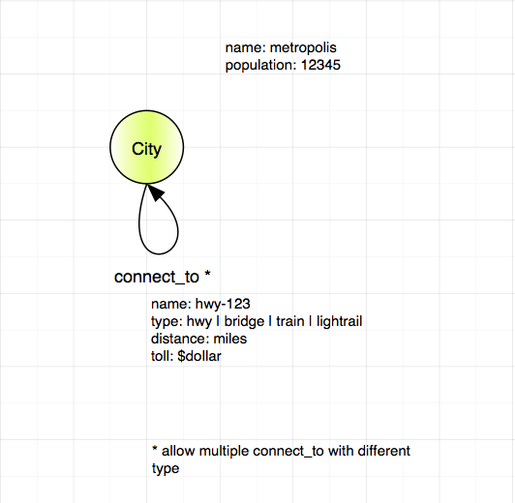
Model – version 0.1 - Simple

Slide 7
Cypher Statement - 1
Add cities.
Add connect_to as relationship between cities.
Verify cities are connected with paths.
Inspect the properties.
Learning the uses of: CREATE, MATCH, RETURN, MERGE, web console.

Slide 8
Model – version 0.2 – more Objects

Slide 9
Cypher Statement - 2
Add more objects:
Schools, Airport, Stadium.
Connect them with relationships:
has.
Use the database to answer some questions.

Slide 10
Model – version 0.3 – More Links

Slide 11
Cypher Statement - 3

Slide 12
Graph Everywhere

Slide 14
GraphGist

Slide 15
Backup and Reference Slides

Slide 16
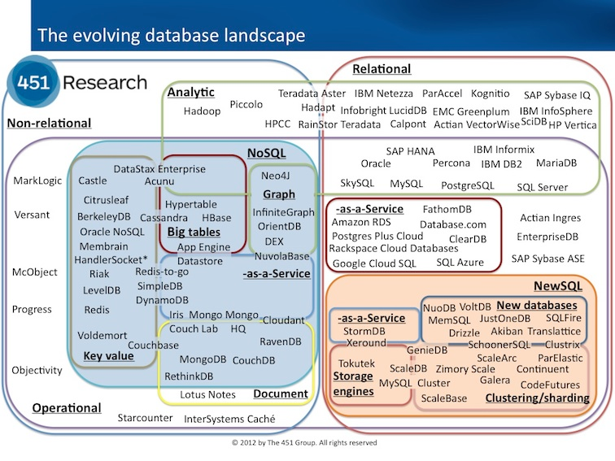
SQL (Structured Query Language) & NOSql (Not Only SQL ) from https://blogs.the451group.com/information_management/files/2012/11/DBlandscape.jpg

Slide 17
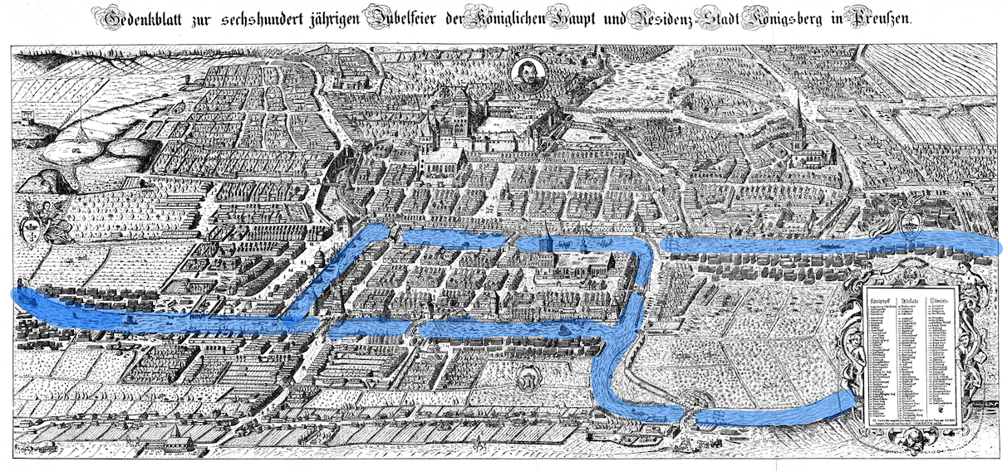
Seven Bridges of Kon

Slide 18






Königsberg (Prussia) - 1736
A
B
C
D
Notes:
Quiz: “Who knows the current name of Königsberg?” - Answer: Kaliningrad.
Euler lived in Königsberg for a while, and in 1736 he created and solved the problem known as the “7 Bridges of Königsberg”. The problem is to decide whether it is possible to follow a path that crosses each bridge exactly once and return to the starting point. This problem was the first study of graph theory.
Königsberg was divided into multiple areas by the Pregel river, and the 7 bridges (animation forward) joined the different city areas together. Euler first identified these 4 land masses (animation forward) and pointed out that the choice of route inside each of the 4 city areas was irrelevant to the problem.
This seems obvious now, but it was a major insight at the time and allowed Euler to reformulate the problem in abstract terms.

Slide 19
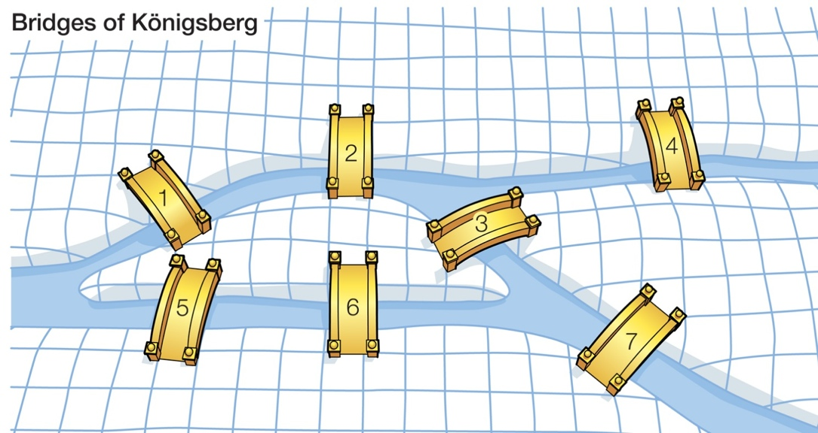
1
A
4
2
B
C
3
6
5
D
7
Notes:
With these two understandings, Euler eliminated all features all features except the list of land masses and the bridges connecting them. In modern terms, one replaces each land mass with an abstract "vertex", and each bridge with an abstract connection, an "edge".
“For normal humans (not mathematicians) we find it easier to use the terms ‘Node’ and ‘Relationship’.”
This resulting structure is called a graph.

Slide 20
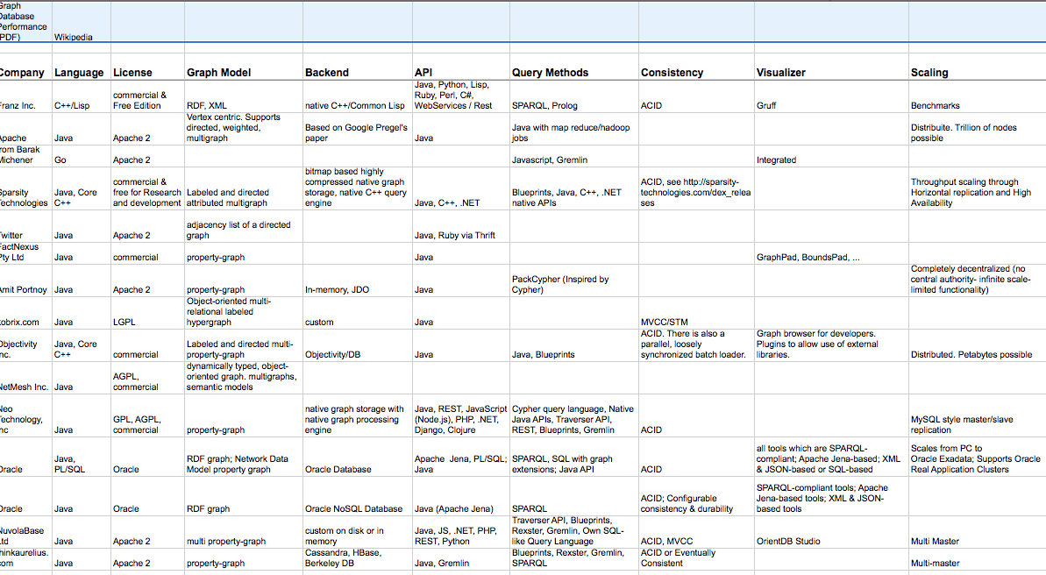
Graph Database

Slide 21
Neo4j

Slide 22
Cypher

Slide 23
References

